Slide 1
Github Assignment
PPT file

Slide 2
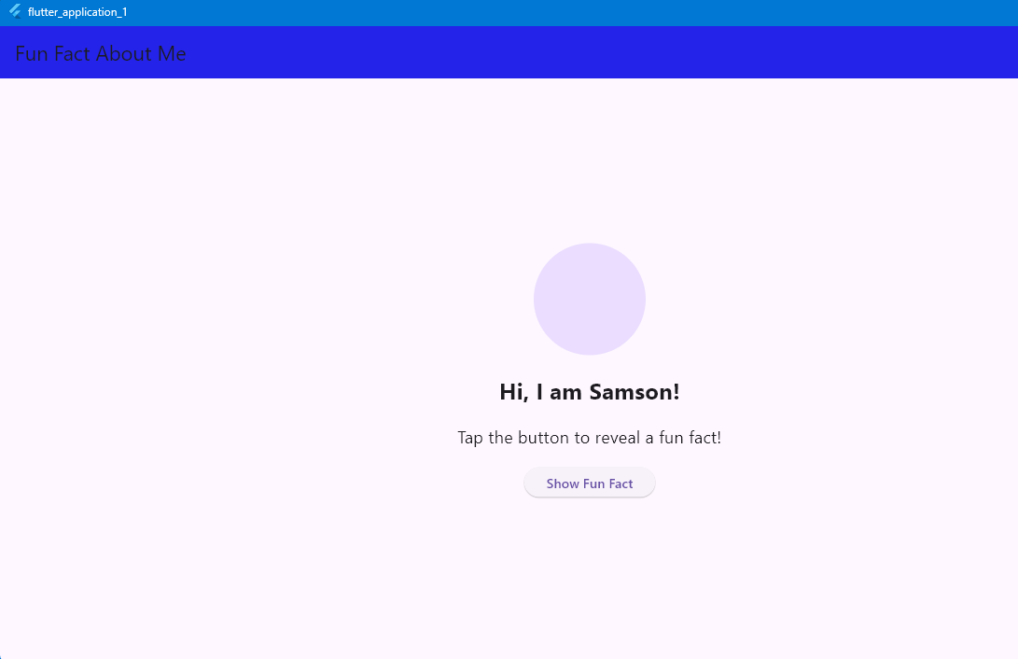
First screenshot

Slide 3
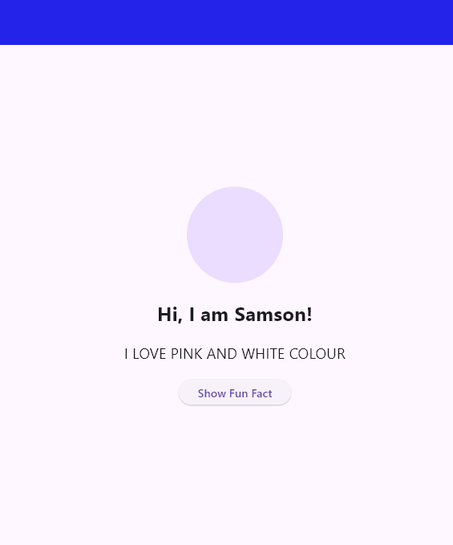
Second screenshot

Slide 4

Third screenshot

Slide 5
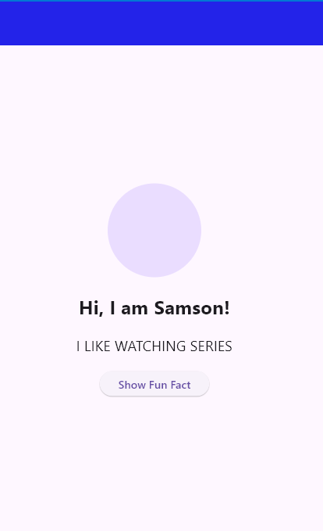
Fourth screenshot

Slide 6
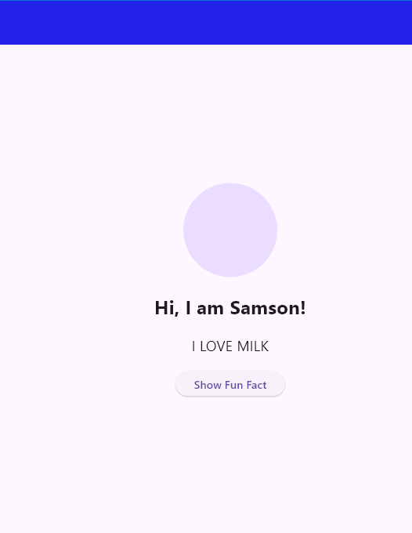
Fifth screenshot

